Slide 1
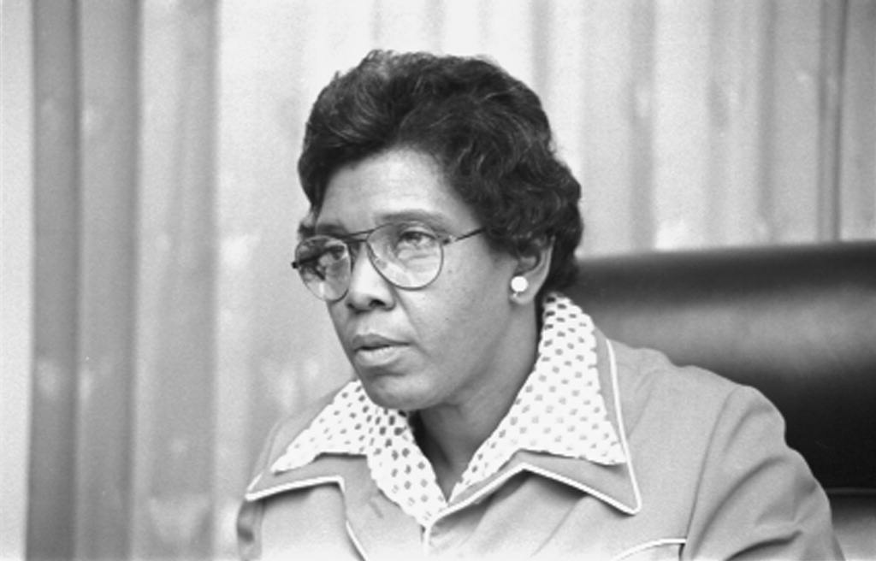
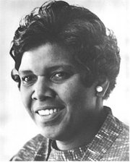
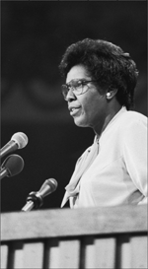
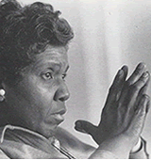
Barbara Jordan
1936-1996

Slide 2
Life
Born February 21, 1936 in Houston, Texas to Baptist minister Benjamin M. Jordan and Arlyne P. Jordan
Attended
  Roberson Elementary
  Wheatley High School
    Member of honors society, excelled in debating
    Graduated in 1952
Graduated with honors from…
  Texas Southern University in 1956
    National champion debater (defeated competitors from Yale and Brown universities, tying those form Harvard)
  Boston University High Law School in 1959

Slide 3
Occupations
Passed the Bar Exams in Massachusetts and Texas
Opened private law practice
Unsuccessfully ran for the Texas House of Representatives in 1962 and 1964
Won a seat in the Texas Senate in 1966
  this made her the first African American woman in senate
Reelected to a full term in 1968, and served until 1972
Elected to the House of Representatives in 1972
  she was also the first African American woman from a southern state to serve in the house
Served briefly as acting governor of Texas in ’72
President Jimmy Carter considered her for Attorney General and U.N. Ambassador, but she opted to stay in congress

Slide 4
Contributions
Was active in the civil rights movement
Sponsored bills for poor and disadvantaged people
  Workmans Compensation act
    Benefits to injured workers
  Voting Rights Act of 1965
    Covered Mexican Americans and minorities denied the right to vote by unfair registration practices
Active in the Kennedy-Johnson presidential campaign
An Influential speaker in support of the impeachment of President Richard Nixon
Gave an important, renowned speech at the 1976 Democratic National Convention

Slide 5
Late Life
Retired from politics in 1979
Professor of Public Affairs at University of Texas at Austin
In 1992, was again a keynote speaker at the Democratic National Convention
Suffered from multiple sclerosis since 1973
Due to health, was unable to be nominated for Supreme Court
Awarded
  Presidential Medal of Freedom in ’94
  United States Military Academy’s Sylvanus Thayer Award
  Elected into the Texas & National Women’s Hall of Fame
Died on January 17, 1996 from Pneumonia

Slide 6
Ideology
Democrat
Active seeker for the rights of minorities
Believed highly in the constitution..
“An America made of diverse people with common beliefs”
“E pluribus Unum” was often one of her sayings (in unity we are one)
Ethical Leadership, Racial equality and harmony
She was
Unknown Religion

Slide 7
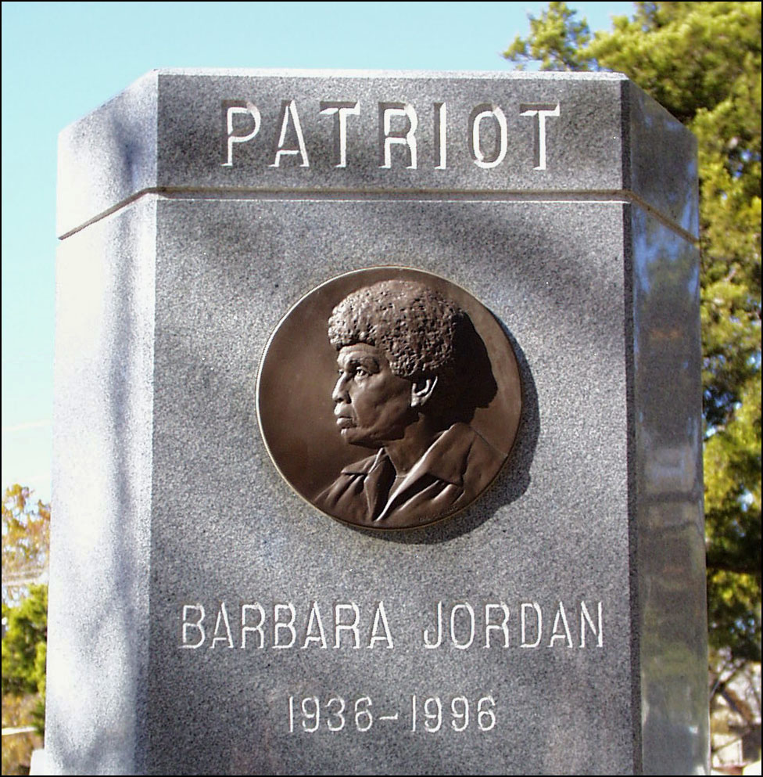
Quotes
After passing a “yes” vote in Nixon’s impeachment she said
  "My faith in the Constitution is whole, it is complete, it is total."
"It is reason, and not passion, which must guide our deliberations, guide our debate, and guide our decision."
Her Democratic National
Convention keynote address

Slide 8
Bibliography
www.wikipedia.org
http://www.beejae.com/bjordan.htm
http://www.ci.austin.tx.us/austinairport/bjbio.htm
http://www.americanrhetoric.com/speeches/barbarajordan1976dnc.html

